Slide 1

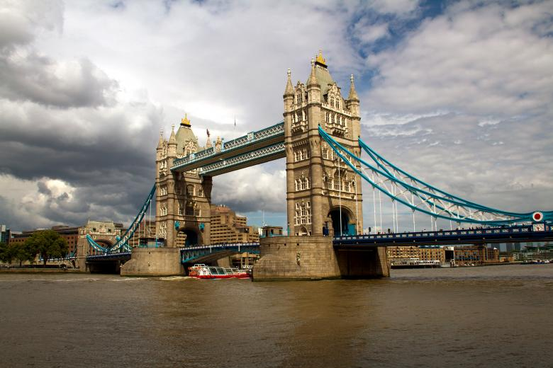
The best borough to open a neighbourhood in Scarborough, Toronto
IBM Capstone Project: Applied Data Science Capstone
By Tarun Aggrawal
July 2021

Slide 2
The purpose of this Capstone Project is to help people in exploring better facilities around their neighborhood. It will help people making smart and efficient decision on selecting great neighborhood out of numbers of other neighborhoods in Scarborough, Toranto.
Main Goal

Slide 3
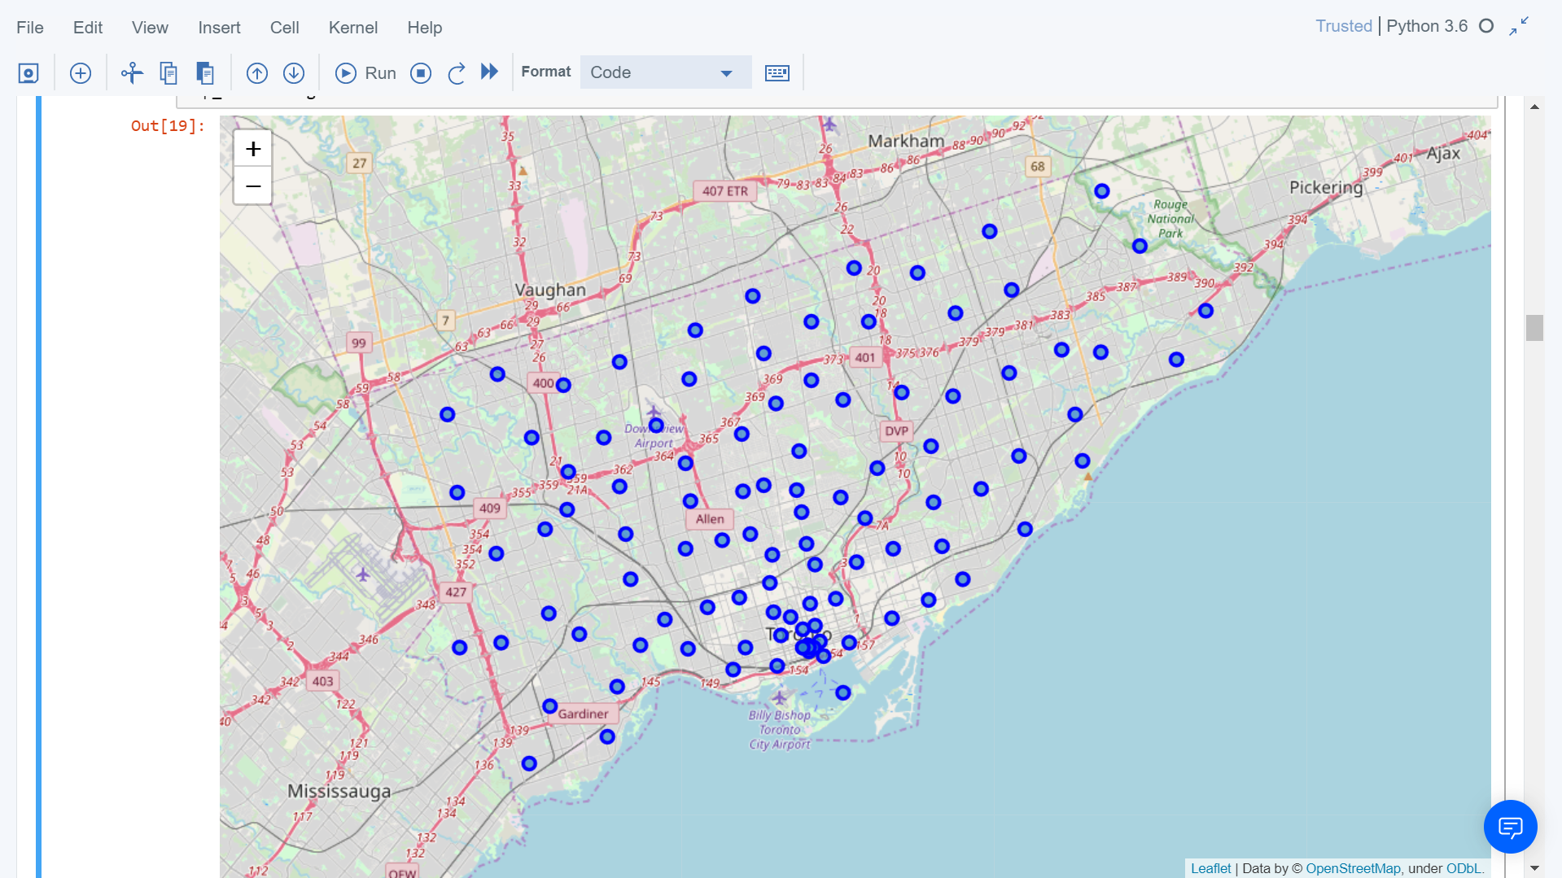
1600 square km
9 million people
33 government districts
multicultural city
tourism

Slide 4


Data sources
Foursquare API
https://ru.foursquare.com/
TripAdvisor
https://www.tripadvisor.com

Slide 5
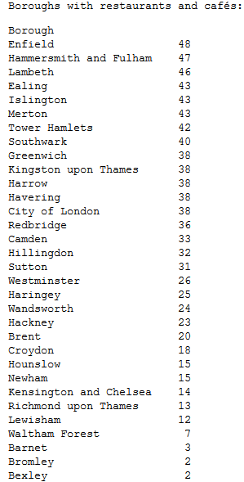
Boroughs vs restaurants
Boroughs vs restaurants,
cafes,
pubs,
bars

Slide 6
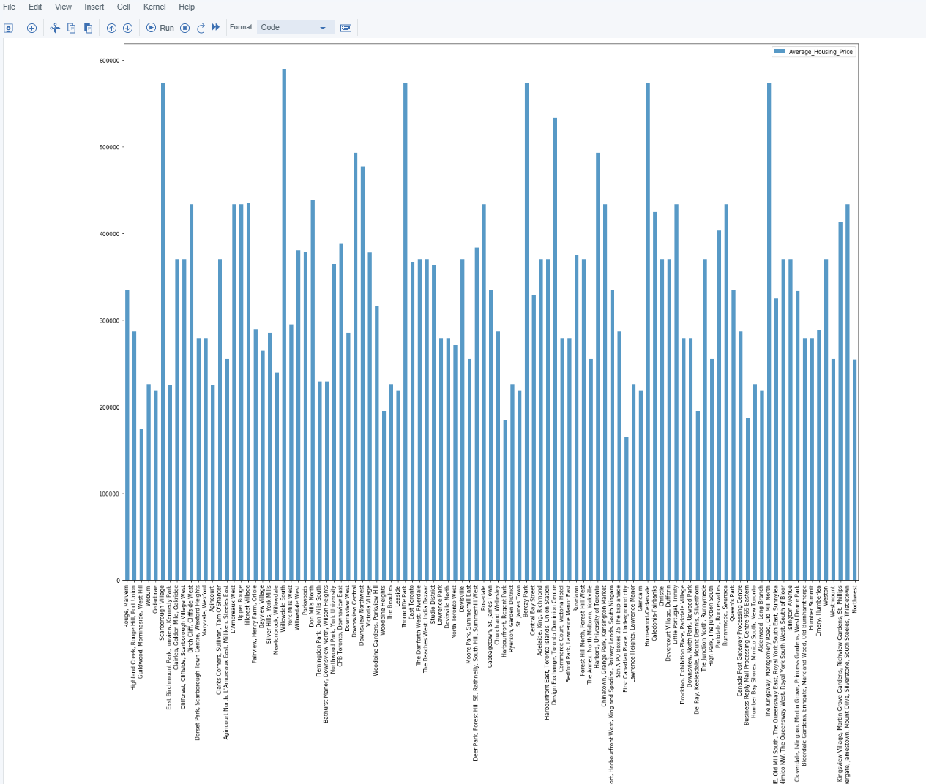
Average housing price

Slide 7
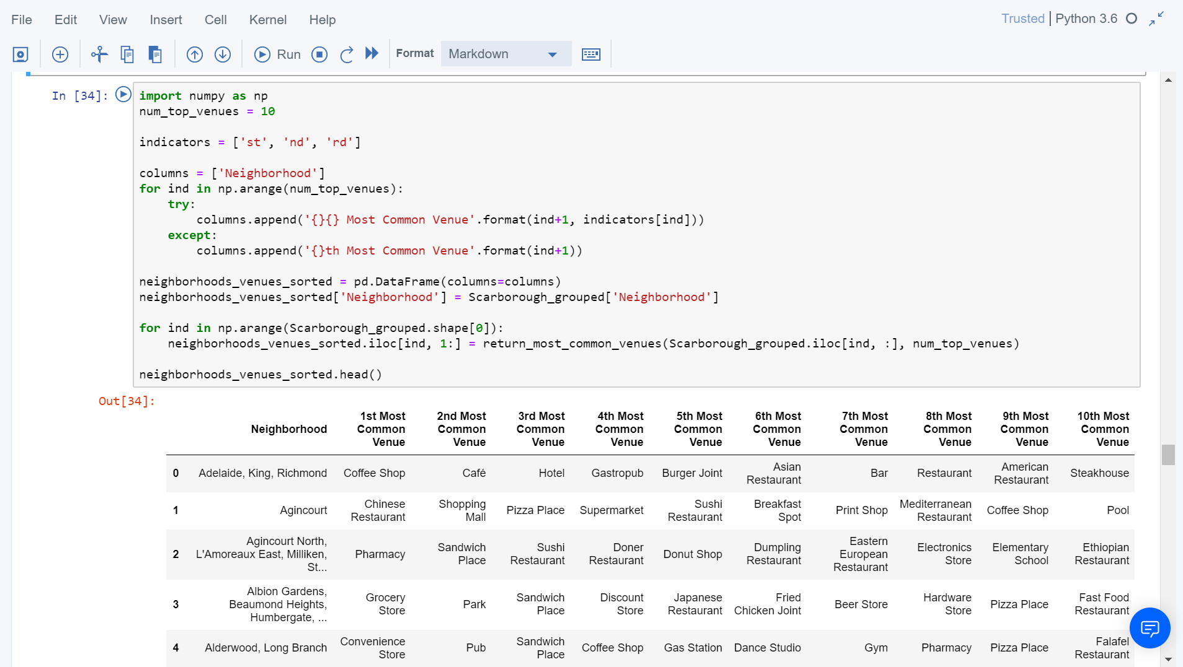
Most Common venues near neighborhood

Slide 8
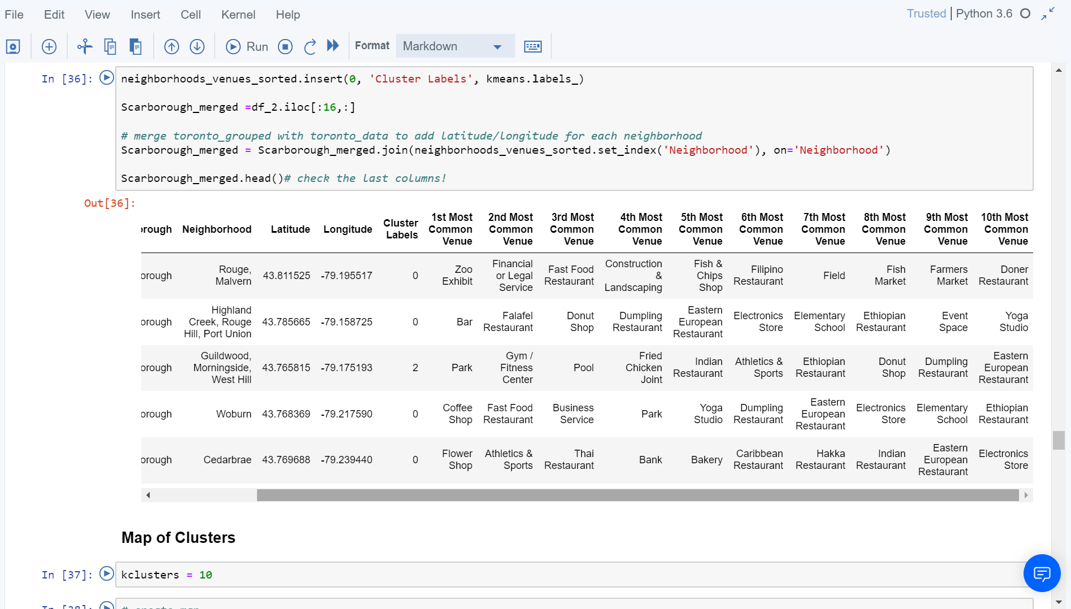
Using K-Means Clustering Approach - 10th Most Common Venue

Slide 9
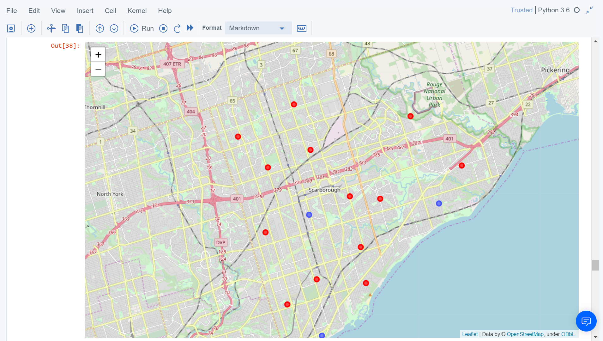
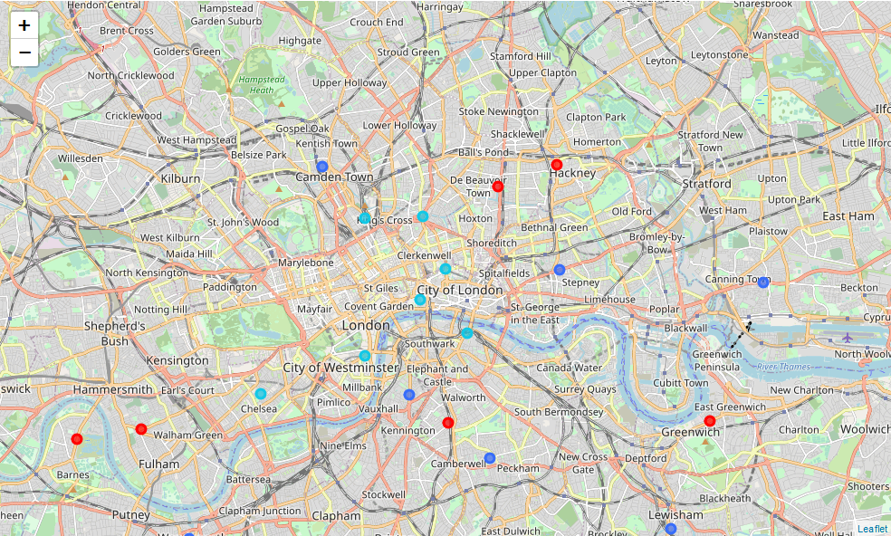
K-means clustering: similar boroughs

Slide 10
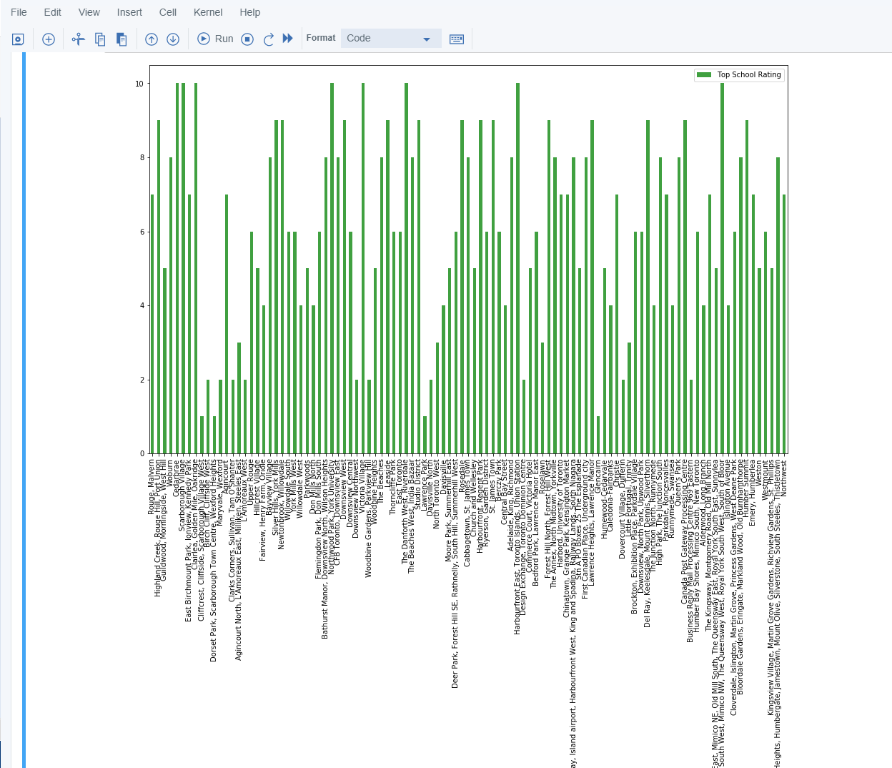
School Ratings by Clusters

Slide 11
Conclusion
In this Capstone project, using k-means cluster algorithm I separated the neighborhood into 10(Ten) different clusters and for 103 different lattitude and logitude from dataset, which have very-similar neighborhoods around them. Using the charts above results presented to a particular neighborhood based on average house prices and school rating have been made.
I feel rewarded with the efforts and believe this course with all the topics covered is well worthy of appreciation.

